Slide 2
Introduction
Traditional annual reports can take months to produce. Staff often scramble and slog from January to August just to gather content that tells the right story. And there’s little proof that traditional annual reports even do the job of engaging advocates and getting financial support for your valuable programs.
There is another way. By posting your achievements regularly on your blog, pulling content from those entries monthly, and filling out this template bit by bit year-round, you’ll be poised for success.
For more tips, check out our blog post on Creating Your Nonprofit Annual Report: Best Practices and Tips.

Slide 3
Add your logo.
ANNUAL REPORT 2023
Insert the current year
Place a photo showing the impact of your work.
Post your annual report on search engine-optimized pages on your website.

Slide 4
CONTENTS
Add table of contents.
Section 1………………………………………….….…3
Section 2………………………………………….….…3
Section 3………………………………………….….…3
Section 4………………………………………….….…3
Add mission and url.
Insert your organization’s boilerplate description of your mission and your work.
www.yoururl.org

Slide 5
TITLE
MESSAGE
From your leadership
Starting with a brief summary of the year’s major activities, developments, and achievements is a good way to inject your leadership’s voice and perspective into the annual report. This is a place to summarize the big picture and offer global observations.
There’s no need to get too specific here. If details are mentioned, they should refer the reader to another page in the annual report.
End with a message of thanks for all that your donors, supporters, and partners do to make your work possible.
Name
Title
Insert a year-end message from your executive director and / or board chair.
// Page 3

Slide 6
TITLE
INSPIRING PHRASE
Name of Program /
Activity Area 1
Use language you’ve used throughout the year in your blog and e-newsletter to talk about achievements, major developments, and improvements in this area.
Insert a bullet point giving an example of what you did in this area this year.
Insert a bullet point giving an example of what you did in this area this year.
Insert a bullet point giving an example of what you did in this area this year.
It’s great practice, once a month, to place content here from your latest blog entry or e-newsletter, so that at the end of the year, you’re annual report is done!
51,000
children
received free
meals at our
centers in 2013
Insert a key performance indicator for this area.
// Page 4

Slide 7
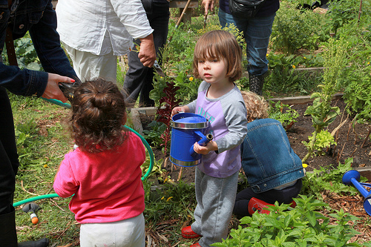
TITLE
Use quotes and callouts to separate content visually.
“
Insert a success story. First-person testimonials are especially powerful.
Insert a success story that relates to program / activity area 1. It can be a brief written testimonial, third-person story, or—better yet—a video showing your work in action. If it’s a video, keep it under 3 minutes and use professional sound and video recording equipment.”
Use a relevant blog / social media image or embedded video.
Insert a caption so readers know what is happening in the photo. Make sure you have releases from anyone shown in the photo.
© d-olwen-dee / Creative Commons License
// Page 5

Slide 8
TITLE
INSPIRING PHRASE
Name of Program /
Activity Area 2
Use language you’ve used throughout the year in your blog and e-newsletter to talk about achievements, major developments, and improvements in this area.
Insert a bullet point giving an example of what you did in this area this year.
Insert a bullet point giving an example of what you did in this area this year.
Insert a bullet point giving an example of what you did in this area this year.
It’s great practice, once a month, to place content here from your latest blog entry or e-newsletter, so that at the end of the year, you’re annual report is done!
51,000
children
received free
meals at our
centers in 2013
Add live social media sharing
links to
the footer.
// Page 6

Slide 9
TITLE
Use the same 3-5 colors and 1-2 fonts throughout.
“
Insert a success story. First-person testimonials are especially powerful.
Insert a success story that relates to program / activity area 2. It can be a brief written testimonial, third-person story, or—better yet—a video showing your work in action. If it’s a video, keep it under 3 minutes and use professional sound and video recording equipment.”
Insert a caption so readers know what is happening in the photo. Make sure you have releases from anyone shown in the photo.
© d-olwen-dee / Creative Commons License
// Page 7

Slide 10
TITLE
INSPIRING PHRASE
Name of Program /
Activity Area 3
Use language you’ve used throughout the year in your blog and e-newsletter to talk about achievements, major developments, and improvements in this area.
Insert a bullet point giving an example of what you did in this area this year.
Insert a bullet point giving an example of what you did in this area this year.
Insert a bullet point giving an example of what you did in this area this year.
It’s great practice, once a month, to place content here from your latest blog entry or e-newsletter, so that at the end of the year, you’re annual report is done!
51,000
children
received free
meals at our
centers in 2013
// Page 8

Slide 11
TITLE
“
Insert a success story. First-person testimonials are especially powerful.
Insert a success story that relates to program / activity area 3. It can be a brief written testimonial, third-person story, or—better yet—a video showing your work in action. If it’s a video, keep it under 3 minutes and use professional sound and video recording equipment.”
Insert a caption so readers know what is happening in the photo. Make sure you have releases from anyone shown in the photo.
© d-olwen-dee / Creative Commons License
// Page 9

Slide 12
TITLE
INSPIRING PHRASE
Name of Program /
Activity Area 4
Use language you’ve used throughout the year in your blog and e-newsletter to talk about achievements, major developments, and improvements in this area.
Insert a bullet point giving an example of what you did in this area this year.
Insert a bullet point giving an example of what you did in this area this year.
Insert a bullet point giving an example of what you did in this area this year.
It’s great practice, once a month, to place content here from your latest blog entry or e-newsletter, so that at the end of the year, you’re annual report is done!
51,000
children
received free
meals at our
centers in 2013
// Page 10

Slide 13
TITLE
“
Insert a success story. First-person testimonials are especially powerful.
Insert a success story that relates to program / activity area 4. It can be a brief written testimonial, third-person story, or—better yet—a video showing your work in action. If it’s a video, keep it under 3 minutes and use professional sound and video recording equipment.”
Insert a caption so readers know what is happening in the photo. Make sure you have releases from anyone shown in the photo.
© d-olwen-dee / Creative Commons License
// Page 11

Slide 14
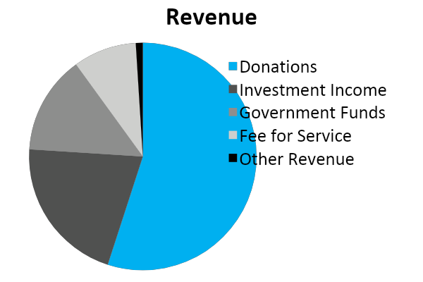
TITLE
2023 FINANCIALS
Revenue
Once a month, update the specific charts you plan to include and have your CFO and ED review them to avoid surprises at year’s end.
Include a brief narrative explaining where your financials came from, how they were audited, and what they mean overall.
1%
9%
14%
55%
21%
// Page 12

Slide 15
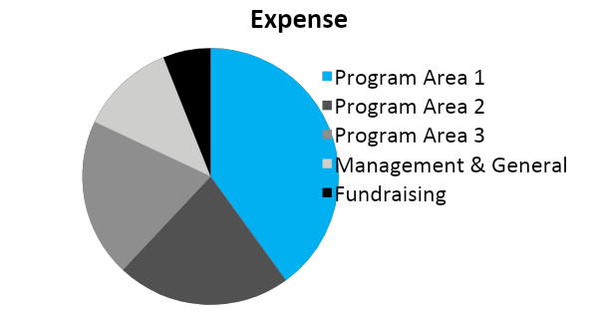
TITLE
2023 FINANCIALS
Expense
6%
12%
40%
20%
22%
// Page 13

Slide 16
TITLE
2023 FINANCIALS
Other Statistics
You may choose to share additional data—about numbers of individuals served by your different program activities or locations, a more detailed breakdown of specific administrative expense versus program expense categories, or other data.
See what data other nonprofit organizations like yours are sharing. You can also check with your state chapter of the Council of Nonprofits to learn more about what if any financial reporting requirements exist for your organization.
// Page 14

Slide 17
TITLE
THANK YOU
Thank all of your supporters for making all of your amazing achievements possible this year. Link to a list of donors updated in real time on your website.
© vastateparksstaff / Creative Commons License
Insert a photo of some supporters
engaged in your work.
// Page 15

Slide 18
TITLE
CALL TO ACTION
A call-to-action is a link or visual object that entices the visitor to click and arrive on a page that will get them further engaged with your organization. For instance, a call-to-action can lead to a web page where people can:
Make an online donation
Sign up for your e-newsletter
Sign up for your conference
Download another publication
Insert your call to action as a text
link and also as
an attention-
getting button.
Text with a link to a landing page
VISUAL
// Page 16

Slide 19
LOGO
Name and
contact information
www.yoururl.org
It can’t hurt to put another call to action
on this page!

Slide 20
Conclusion
Now that you’ve collected the content you need for your annual report, it’s time to disseminate it. Make sure you’re optimizing your annual report content so that it gets into the hands of your ideal advocates and donors. And learn more tips for boosting speed and revenue through your annual report.

Slide 21
Want help producing an annual report that mobilizes advocates
and builds revenue?
Learn about our nonprofit annual report design packages >

